Slide 1
Sleeping Pattern Analysis
Vamshi Thatikonda
Karthik Mundgemane
Sumith Kumar

Slide 2
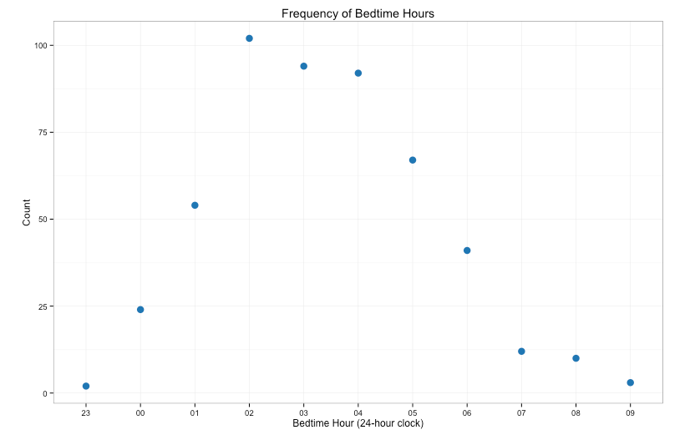
Introduction
The agenda is to analyse a person’s sleeping pattern based on the given sleep data
We have used R to analyse the data using Linear regression
The above graph shows the common bedtime hours of the person which is at around 2 am in the morning.

Slide 3
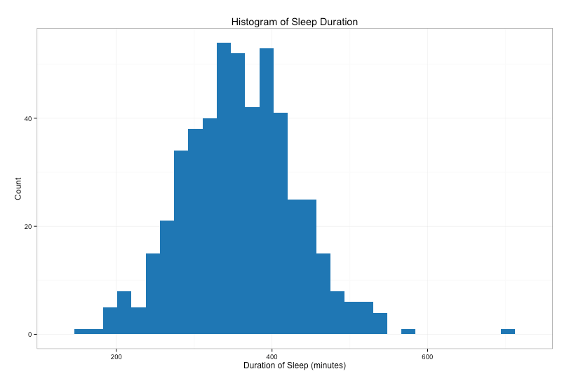
Sleep Duration
This histogram determines how often the person slept for when the person fell asleep

Slide 4
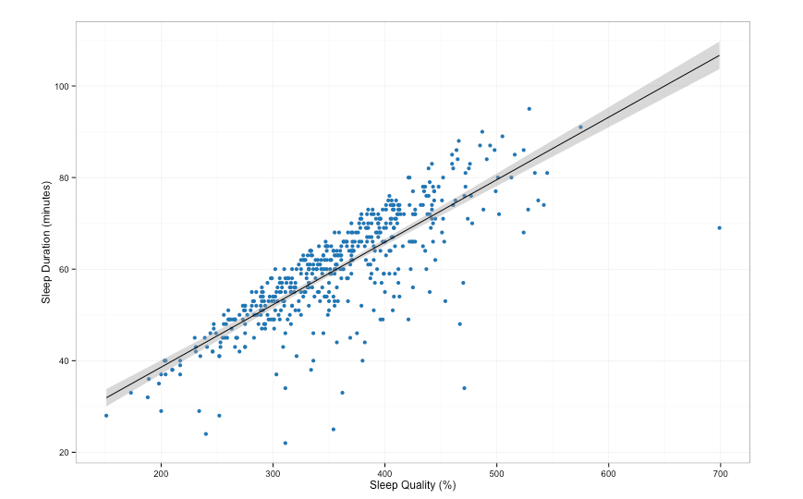
Sleep quality over time
According to the graph below, it is possible for sleep quality to increase even when sleep duration decreases. So perhaps even though sleeping for shorter durations got the person better sleep overall.

